Slide 1
Stock Price prediction using Big Data Visualization Technique
Priyanka Vyas, Nibedita Roy,
pvyas2@kent.edu , nroy2@kent.edu
Department of Computer Science
Kent State University

Slide 2
Actionable:
Explored the dataset using Tableau
Code for downloading the dataset from the source
Finalized the part of dataset and the features to be implemented
Studied relevant frameworks (tensorflow, pytorch, or any other framework)
Report:
Referred sections II-A and II-B for study and to outline the project report
Milestone 1

Slide 3
Project Workflow
Data Collection
Data Preprocessing
Training Data
Prediction Analysis
Data Visualization

Slide 4
Dataset: Source
Nasdaq
https://www.nasdaq.com/
Framework
Python 3.9
Tableau

Slide 5
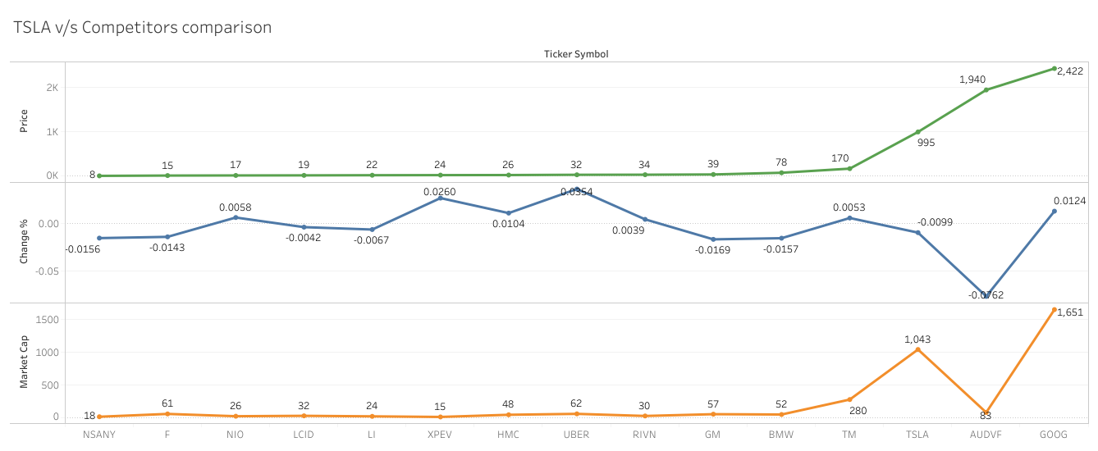

Slide 6
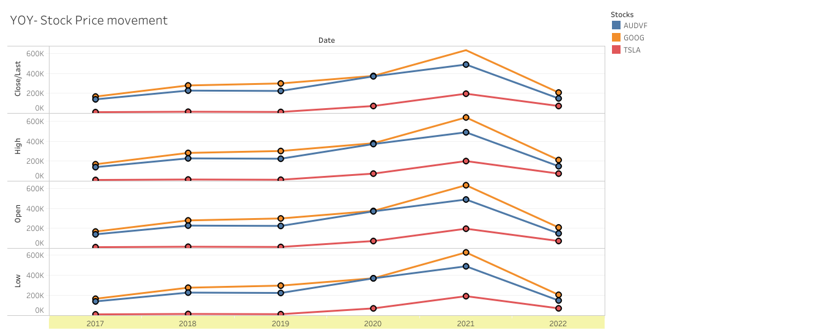

Slide 7
Problem Statement:
-Prediction of future movement of stock prices
Proposed Solution:
- Neural networks model
- Monitor the price movement
- Visualization method to present and analysis the result

Slide 8
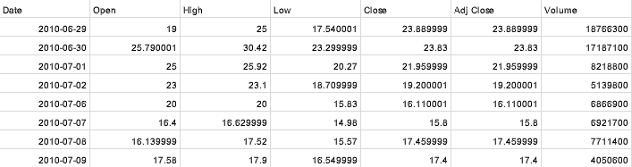
Features of Dataset
Properties:
•Total sample size: 2517
•Training set size: TBD
•Test set size:TBD
• Dataset parameters/ Categories:Date,Open,High,Low, Close, Adj Close and Volume

Slide 9
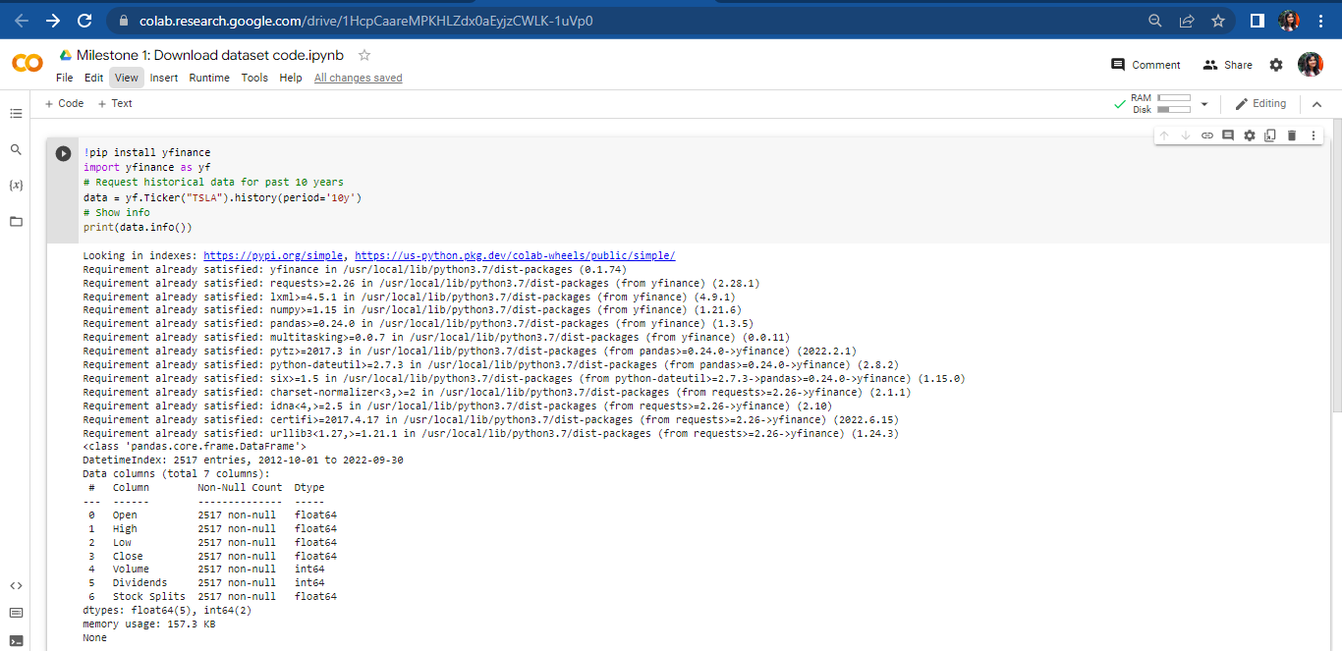
https://colab.research.google.com/drive/1HcpCaareMPKHLZdx0aEyjzCWLK-1uVp0

Slide 10
Code for Dataset download
Used Google Collab and Keras to execute the code
Import libraries like yfinance for historical data of securities.
TSLA Stock data downloaded
History/period-10 years
Viewed the data info to confirm data attributes

Slide 11
Code Workflow
Google Collab+Keras
Define functions for imports
Data loading and preprocessing
Compile and Train the model
LSTM model-based Prediction

Slide 12
Thank You

